Slide 1

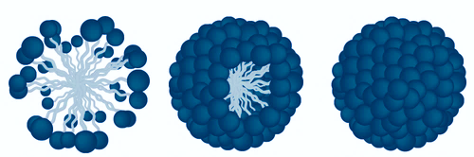
Micelles
UNIVERSITY OF CRETE
DEPARTMENT OF CHEMISTRY
Styliani Afroditi Mountaki, 1059
Course: Supramolecular Chemistry
Heraklion 2020

Slide 2
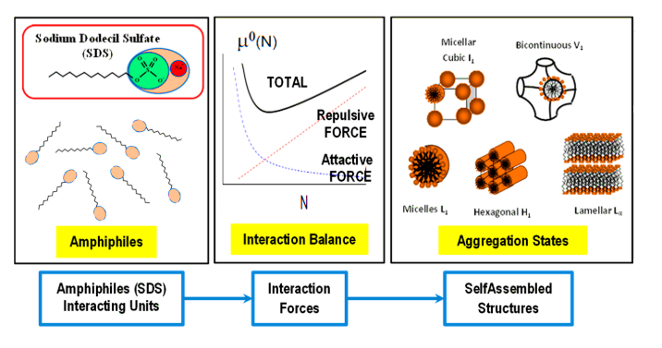
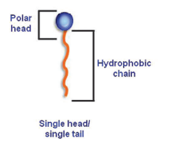
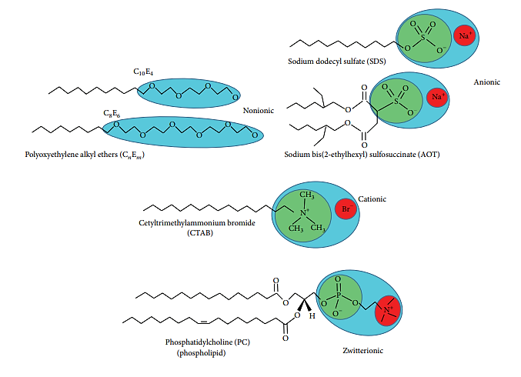
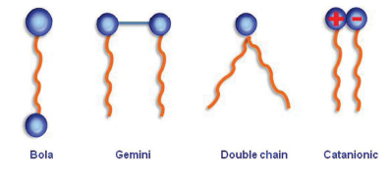
Surfactants
Amphiphils consisting of a polar head group and a non-polar hydrocarbon chain
Several applications: cleaning, wetting, dispersing, emulsifying, foaming and anti-foaming agents in paints, inks, biocides (sanitizers), shampoos, toothpastes, firefighting (foams), detergents, insecticides, spermicides etc.
Accumulates between fluid phases reducing the surface and interfacial tensions and forming micelles/emulsions

Slide 3
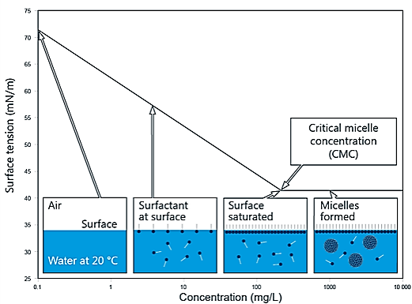
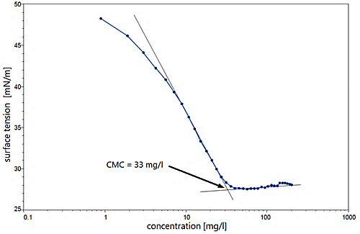
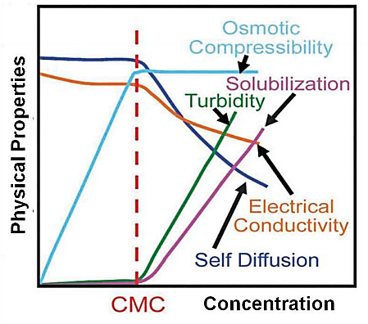
Micellization
Critical Micelle Concentration
CMC is the concentration of a surfactant in a bulk phase, above which micelles, start to form
CMC is a measure of the efficiency of a surfactant
Decrease: alkyl chain length, salt concentration, temperature decrease
Increase: branching of chain, ionized groups

Slide 4
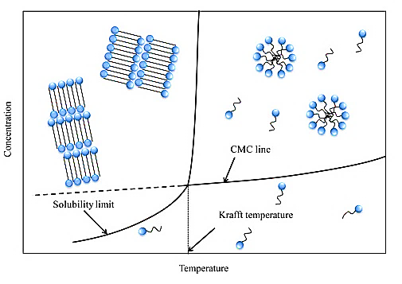
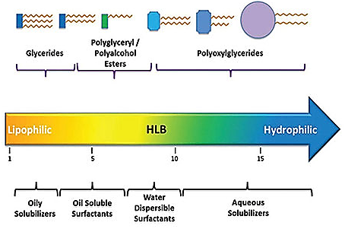
Micellization
Krafft Temperature:
Hydrophilic-Lipophilic Balance:
The temperature at which the solubility of ionic surfactants in water increases drastically
Increase: alkyl chain length, salt concentration
Decrease: tampering with hydrophobic part (branching of chain, unsaturated alkyl chain, alternate alkyl with siloxane chain)
Balance of the size and strength of the hydrophilic and lipophilic moieties of a surfactant molecule
Does not take into account polar head hydration and hydrocarbon chain unsaturation

Slide 5
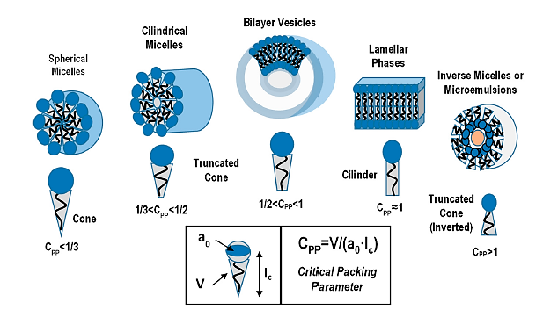
Shapes
Critical Packing Parameter

Slide 6
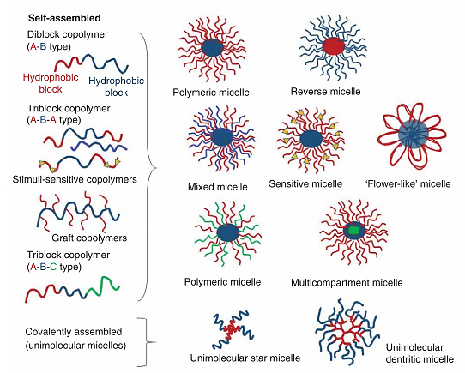
Polymeric Amphiphiles

Slide 7
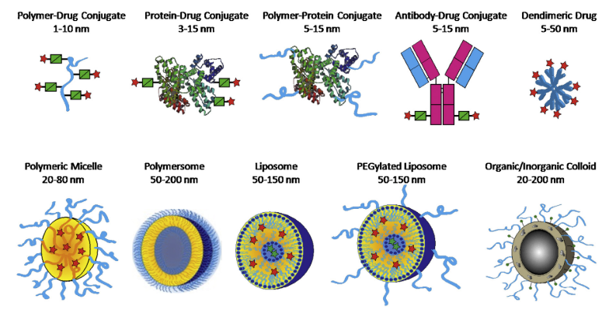
Drug Delivery

Slide 8
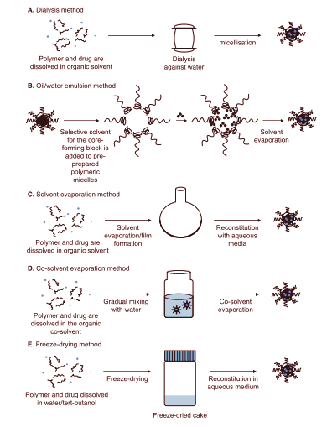
Drug Delivery
Micellization Methods
Advantages
Solubilization of hydrophobic drugs
Protection from inactivation in the biological milieu
Increased bioavailability
Small size allows them to circulate in the blood for extended periods
High structural stability allows retaining encapsulated drugs
Stable upon dilution in the body
Reduced side effects
Easy and reproducible scale-up
Surface modified with ligands for targeted micelles

Slide 9
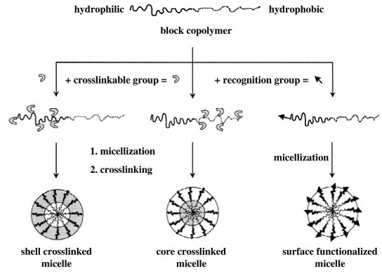
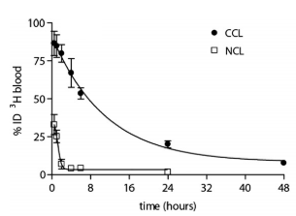
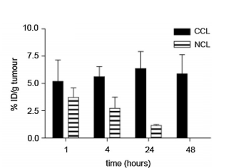
Drug Delivery
In-vivo Stabilization
Circulation kinetics and tumor accumulation of non-core-crosslinked (NCL) and core-crosslinked (CCL) polymeric micelles in tumor bearing mice

Slide 10
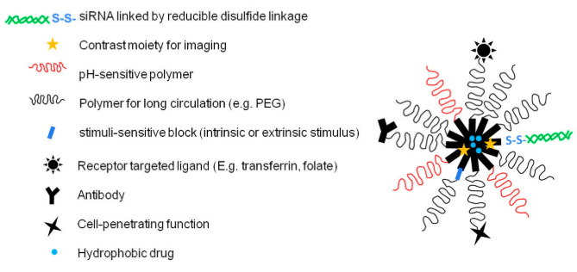
Drug Delivery
Responsive Micelles

Slide 11
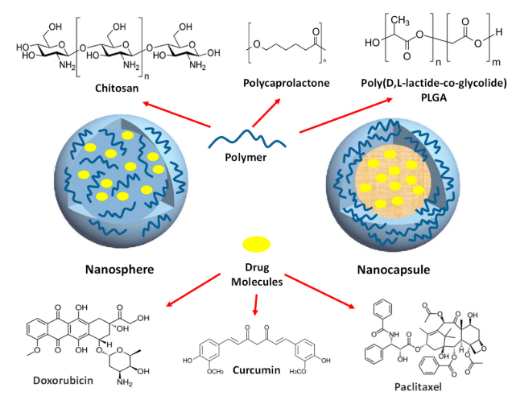
Drug Delivery

Slide 12
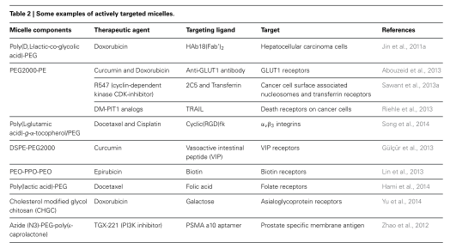
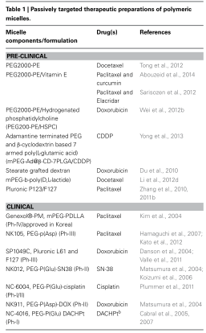
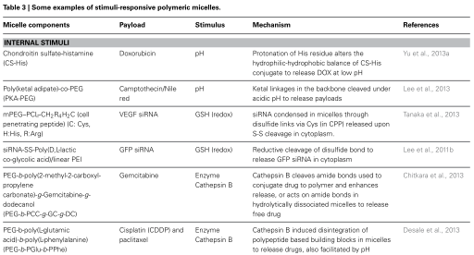
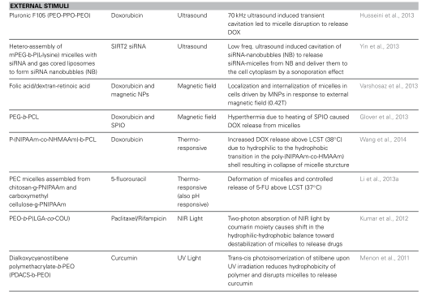
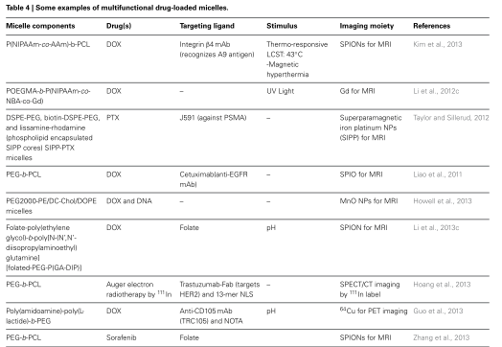
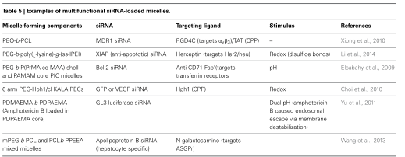
Drug Delivery

Slide 13
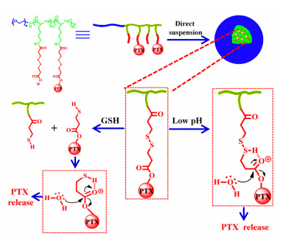
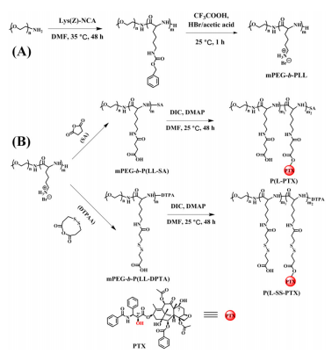
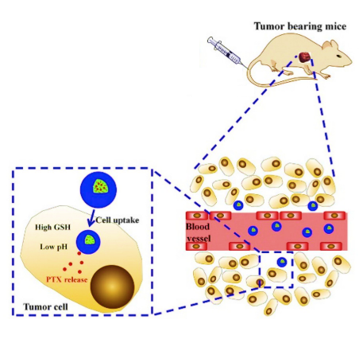
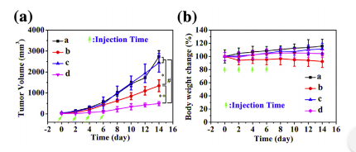
Dual Responsive Micelles
Intravenous injection
Tumor volume (A) and body weight change (B) in C57BL/6 mice bearing mouse melanoma B16F1 xenograft. (a) PBS, (b) free PTX (10 mg kg−1), (c) P(L-PTX) (10 mg PTX kg−1) and (d) P(L-SS-PTX) (10 mg PTX kg−1).

Slide 14
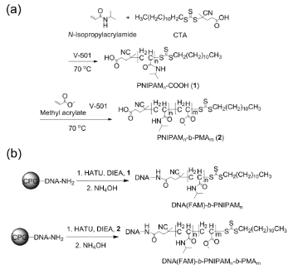
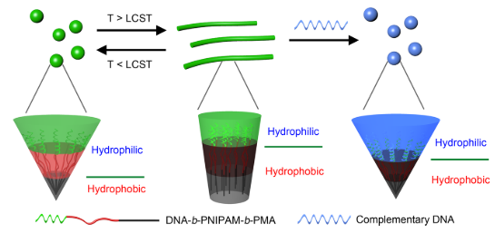
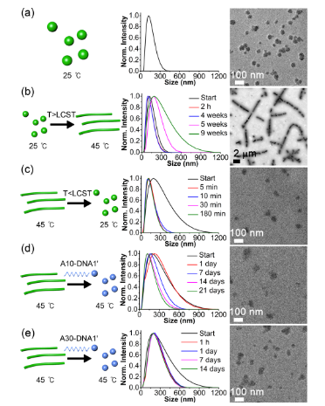
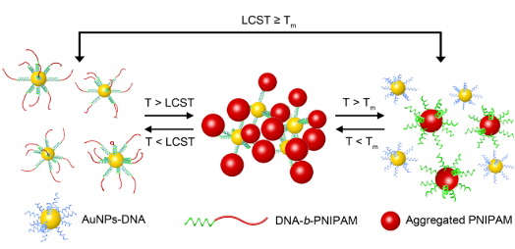
Targeted Responsive Micelles
Dual-responsive morphology change and recovery of DNA1(FAM)-b-PNIPAM183-b-PMA118 micelles detected by DLS and TEM

Slide 15
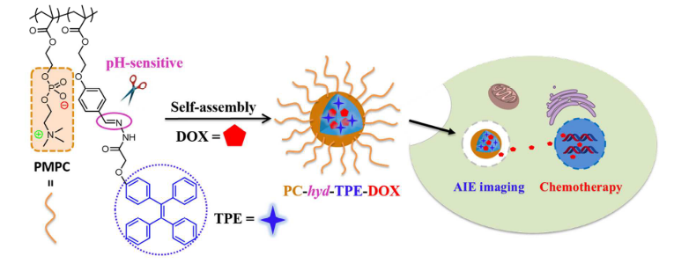
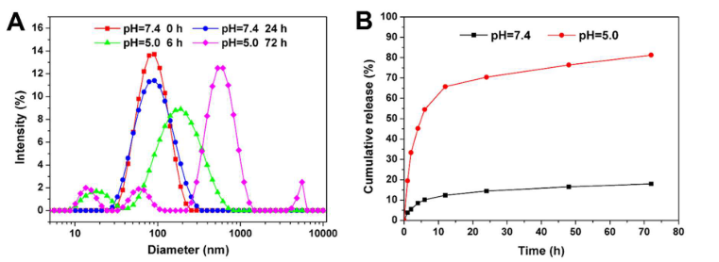
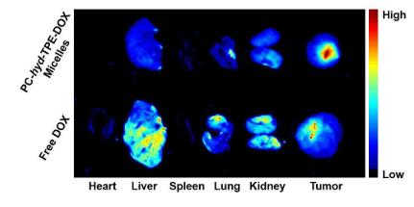
Theranostics
(A) pH-Triggered disassembly monitored by DLS and (B) in vitro DOX release of PC- hyd-TPE-DOX micelles

Slide 16
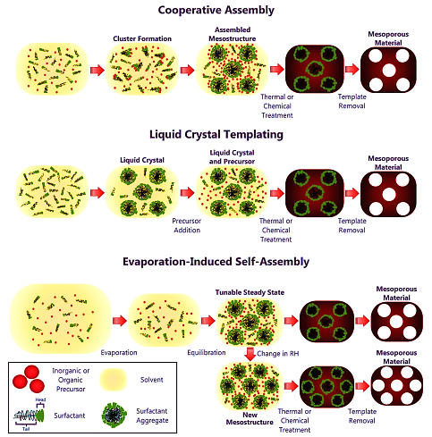
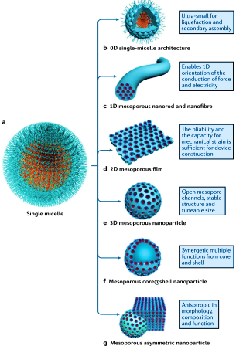
Soft Templating

Slide 17
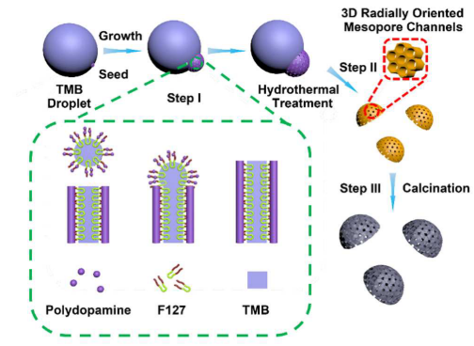
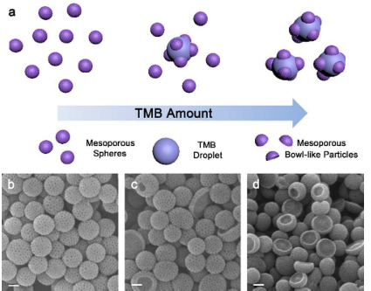
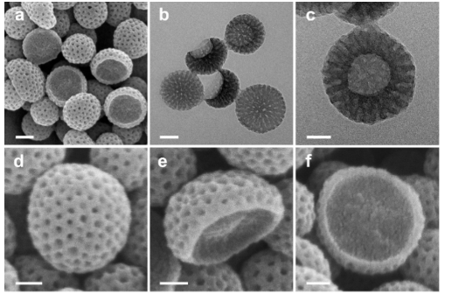
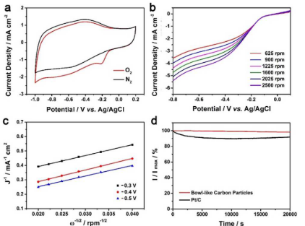
Assymetric Mesoporous Synthesis
Electrochemical characterizations of bowl-like mesoporous carbon particles as an electrocatalyst for ORR. (a) CV curves (b) LSV curves at different potentials from the LSV curves shown in (b) (c) Corresponding Koutecky-Levich (d) Durability test

Slide 18
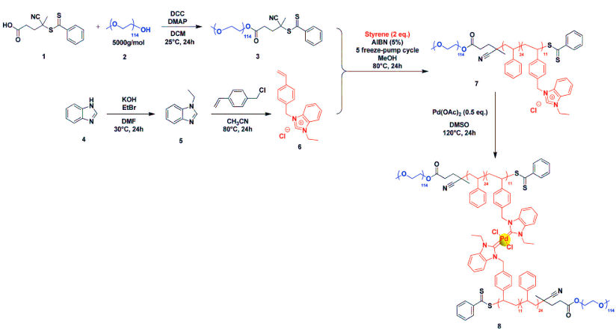
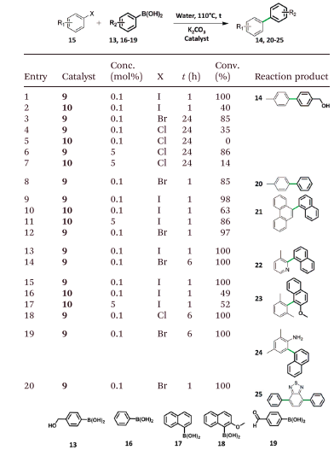
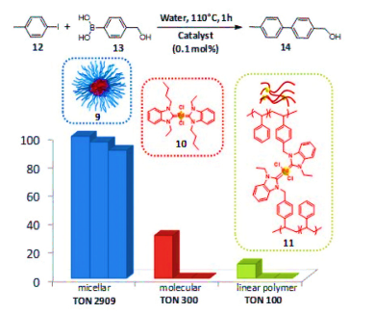
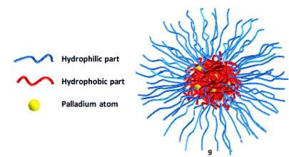
Micellar Catalysis
Nanoprecipitation in water
Suzuki coupling of 4-(hydroxymethyl)phenylboronic acid and iodotoluene using 9,or 10 or 11. The three bars refer to the 1st, the 2nd and the 3rd catalytic cycle, respectively

Slide 19
References
https://www.kruss-scientific.com/services/education-theory/glossary/critical-micelle-concentration-cmc-and-surfactant-concentration/
https://www.sciencedirect.com/topics/chemistry/krafft-point
https://www.pharmaexcipients.com/news/are-lipid-based-drug-delivery-systems-in-your-formulation-toolbox/
Aliabadi, Hamidreza Montazeri, Afsaneh Lavasanifar, Hamidreza Montazeri Aliabadi, and Afsaneh Lavasanifar. 2017. “Expert Opinion on Drug Delivery Polymeric Micelles for Drug Delivery Polymeric Micelles for Drug.” 5247(October).
Bezerra, Marcos Almeida, and Sergio L C Ferreira. 2005. “Cloud Point Extraction as a Procedure of Separation and Pre ‐ Concentration for Metal Determination Using Spectroanalytical Technique .... Cloud Point Extraction as a Procedure of Separation and Pre-Concentration for Metal Determination Using Spectroanalytical Techniques : A Review.” (October 2015).
Chen, Yangjun et al. 2016. “Zwitterionic Phosphorylcholine-TPE Conjugate for PH-Responsive Drug Delivery and AIE Active Imaging.” ACS Applied Materials and Interfaces.
Croy, S R, and G S Kwon. 2006. “Polymeric Micelles for Drug Delivery.” : 4669–84.
Figueiras, Ana R, Francisco Veiga, and Angel Concheiro. 2015a. “Polymeric Micelles for Oral Drug Administration Enabling Locoregional and Systemic Treatments.” Expert Opinion Drug Delivery 12(2): 1–22.
———. 2015b. “Polymeric Micelles for Oral Drug Administration Enabling Locoregional and Systemic Treatments.” (September 2014).
García, M C, C Aloisio, and R Onnainty. 2018. Nanobiomaterials Self-Assembled Nanomaterials. Elsevier Ltd. https://doi.org/10.1016/B978-0-08-100716-7.00003-9.
Guan, Bu Yuan, Le Yu, Xiong Wen, and David Lou. 2016. “Formation of Asymmetric Bowl-Like Mesoporous Particles via Emulsion-Induced Interface-Anisotropic Assembly.” Journal of American Chemical Society.
Hussein, Yasser H A. 2018. “Polymeric Micelles of Biodegradable Diblock Copolymers : Enhanced Encapsulation of Hydrophobic Drugs.”
Jhaveri, Aditi M, and P Vladimir. 2014. “Multifunctional Polymeric Micelles for Delivery of Drugs and SiRNA.” Frontiers in Pharmacology (4).
Kataoka, Kazunori, Atsushi Harada, and Yukio Nagasaki. 2012. “Block Copolymer Micelles for Drug Delivery: Design , Characterization and Biological Significance.” Advanced Drug Delivery Reviews 64: 37–48. http://dx.doi.org/10.1016/j.addr.2012.09.013.
Kim, Chan-jin, Xiaole Hu, and So-jung Park. 2016. “Multimodal Shape Transformation of Dual-Responsive DNA Block Copolymers.” Journal of American Chemical Society.
Lambert, Romain, Anne-laure Wirotius, Joan Vignolle, and Daniel Taton. 2018. “C–C Couplings in Water by Micellar Catalysis at Low Loadings from a Recyclable Polymer-Supported Pd(Ii)–NHC Nanocatalyst.” Polymer Chemistry.
Lombardo, Domenico, Pietro Calandra, Luigi Pasqua, and Salvatore Magazù. 2020. “Self-Assembly of Organic Nanomaterials and Biomaterials : The Bottom-Up Approach for Functional Nanostructures Formation and Advanced Applications.” Materials 13(1048).
Lombardo, Domenico, Mikhail A Kiselev, Salvatore Magazù, and Pietro Calandra. 2015. “Amphiphiles Self-Assembly : Basic Concepts and Future Perspectives of Supramolecular Approaches.” Advances in Condensed Matter Physics 2015.
Lu, Ying, and Kinam Park. 2013. “Polymeric Micelles and Alternative Nanonized Delivery Vehicles for Poorly Soluble Drugs.” International Journal of Pharmaceutics 453(1): 198–214. http://dx.doi.org/10.1016/j.ijpharm.2012.08.042.
Lu, Yingqing et al. 2020. “Self-Assembly of Copolymer Micelles : Higher-Level Assembly for Constructing Hierarchical Structure.” Chemical Reviews.

Slide 20
References
Lu, Yingqing et al. 2020. “Self-Assembly of Copolymer Micelles : Higher-Level Assembly for Constructing Hierarchical Structure.” Chemical Reviews.
Lv, Shixian et al. 2014. “Well-de Fi Ned Polymer-Drug Conjugate Engineered with Redox and PH-Sensitive Release Mechanism for Ef Fi Cient Delivery of Paclitaxel.” Journal of Controlled Release 194: 220–27. http://dx.doi.org/10.1016/j.jconrel.2014.09.009.
Mallya, Pooja et al. 2020. “Recent Developments in Nano Micelles as Drug Delivery System.” INTERNATIONAL JOURNAL OF RESEARCH IN PHARMACEUTICAL SCIENCES 11(1): 176–84.
Petkovich, Nicholas D, Andreas Stein, and Andreas Stein. 2012. “Controlling Macro- and Mesostructures with Hierarchical Porosity through Combined Hard and Soft Templating w z Y.” Chemical Society Reviews 42(8): 3721–3739.
Ramanathan, Muruganathan et al. 2013. “Amphiphile Nanoarchitectonics: From Basic Physical Chemistry to Advanced Applications.” Phys. Chem. Chem. Phys.
Rapoport, Natalya. 2007. “Physical Stimuli-Responsive Polymeric Micelles for Anti-Cancer Drug Delivery.” Progress in Polymer Science 32: 962–90.
Shi, Yang, Twan Lammers, Gert Storm, and Wim E Hennink. 2017. “Physico-Chemical Strategies to Enhance Stability and Drug Retention of Polymeric Micelles for Tumor-Targeted Drug Delivery.” Macromolecular Bioscience 201600160: 1–11.
Sorrenti, A., O. Illa, and R. M. Ortuno. 2013. “Amphiphiles in Aqueous Solution: Well beyond a Soap Bubble.” Chemical Society Reviews 42: 8200–8219.
Taddese, Tseden, Richard L Anderson, David J Bray, and Patrick B Warren. 2020. “Recent Advances in Particle-Based Simulation of Surfactants.” Current Opinion in Colloid & Interface Science. https://doi.org/10.1016/j.cocis.2020.04.001.
Talelli, Marina et al. 2015. “Core-Crosslinked Polymeric Micelles : Principles , Preparation , Biomedical Applications and Clinical Translation.” Nano Today. http://dx.doi.org/10.1016/j.nantod.2015.01.005.
Talelli, Marina, Cristianne J F Rijcken, Wim E Hennink, and Twan Lammers. 2012. “Polymeric Micelles for Cancer Therapy : 3 C ’ s to Enhance Efficacy.” Current Opinion in Solid State & Materials Science 16(6): 302–9. http://dx.doi.org/10.1016/j.cossms.2012.10.003.
Wang, Chao, Zhiqiang Wang, and X I Zhang. 2012. “Amphiphilic Building Blocks for Self-Assembly : From Amphiphiles to Supra-Amphiphiles.” 45(4).
Wyman, Ian W, and Guojun Liu. 2013. “Micellar Structures of Linear Triblock Terpolymers : Three Blocks but Many Possibilities.” Polymer 54(8): 1950–78. http://dx.doi.org/10.1016/j.polymer.2012.12.079.
Yang, Haotong et al. 2020. “Stimuli-Responsive Polymeric Micelles for the Delivery of Paclitaxel.” Journal of Drug Delivery Science and Technology 56(December 2019): 101523. https://doi.org/10.1016/j.jddst.2020.101523.
Zhao, Tiancong, Ahmed Elzatahry, Xiaomin Li, and Dongyuan Zhao. 2020. “Single-Micelle-Directed Synthesis of Mesoporous Materials.” Nature Reviews Materials. http://dx.doi.org/10.1038/s41578-019-0144-x.

Slide 21

Thank you!

